Slide 1
Mass Storage Systems
Hamid R. Zarandi
h_zarandi@aut.ac.ir

Slide 2
Magnetic disk structure

Slide 3
Overview of mass storage structure
Magnetic disks
Bulk of secondary storage of modern computers
Transfer rate is rate at which data flow between drive and computer
Positioning time (random-access time)
Seek time: time to move disk arm to desired cylinder
Rotational latency: time for desired sector to rotate under the disk head
Head crash results from disk head making contact with the disk surface -- That’s bad
Some drives attached to computer via I/O bus
Busses vary, including EIDE, ATA, SATA, USB, Fiber Channel, SCSI, SAS, Firewire
Host controller in computer uses bus to talk to disk controller built into drive or storage array

Slide 4
Magnetic disk performance
Access Latency = Average access time = average seek time + average rotation latency
For fastest disk 3ms + 2ms = 5ms
For slow disk 9ms + 5.56ms = 14.56ms
Average I/O time = average access time
+ (amount to transfer / transfer rate)
+ controller overhead

Slide 5
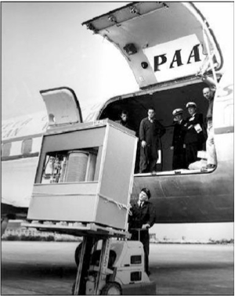
1st commercial disk drive
1956
IBM RAMDAC computer included the IBM Model 350 disk storage system
5M (7 bit) characters
50 x 24” platters
Access time = < 1 second

Slide 6
Disk scheduling
The operating system is responsible for using hardware efficiently — for the disk drives, this means having a fast access time and disk bandwidth
Minimize seek time
Seek time ≈ seek distance
Disk bandwidth
The total number of bytes transferred, divided by the total time between the first request for service and the completion of the last transfer

Slide 7
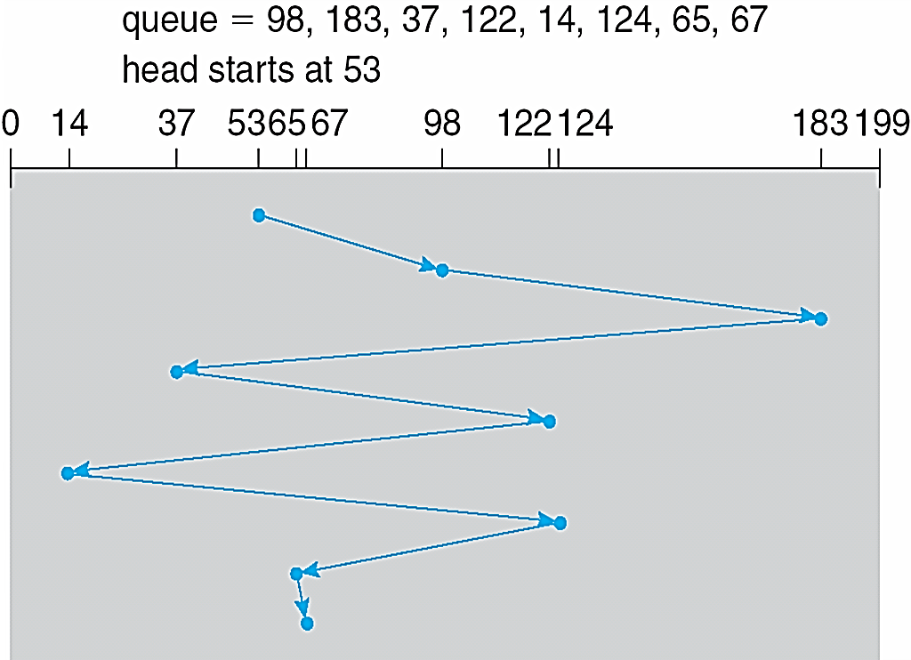
FCFS (First come first serve)
Response to request queue based on FCFS
Head movement = 640 cylinders

Slide 8
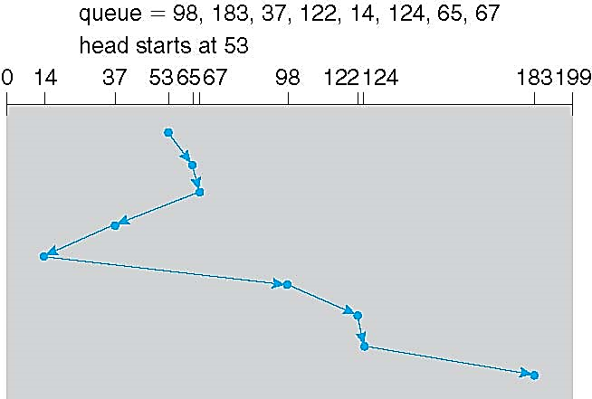
SSTF (Shortest Seek Time First)
Selects the request with the minimum seek time from the current head position
SSTF scheduling is a form of SJF scheduling; may cause starvation of some requests
Head movement = 208 cylinders

Slide 9
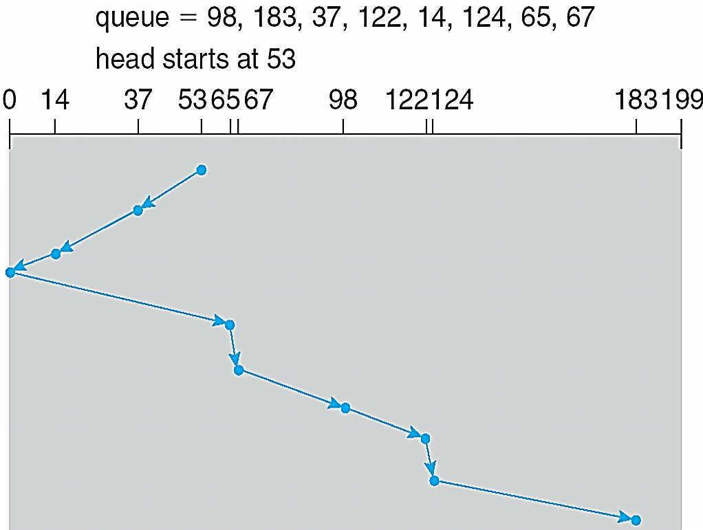
SCAN
The disk arm starts at one end of the disk, and moves toward the other end
Servicing requests until it gets to the other end of the disk, where
The head movement is reversed and servicing continues.
SCAN algorithm sometimes called the elevator algorithm
If requests are uniformly dense, largest density at other end of disk and those wait the longest

Slide 10
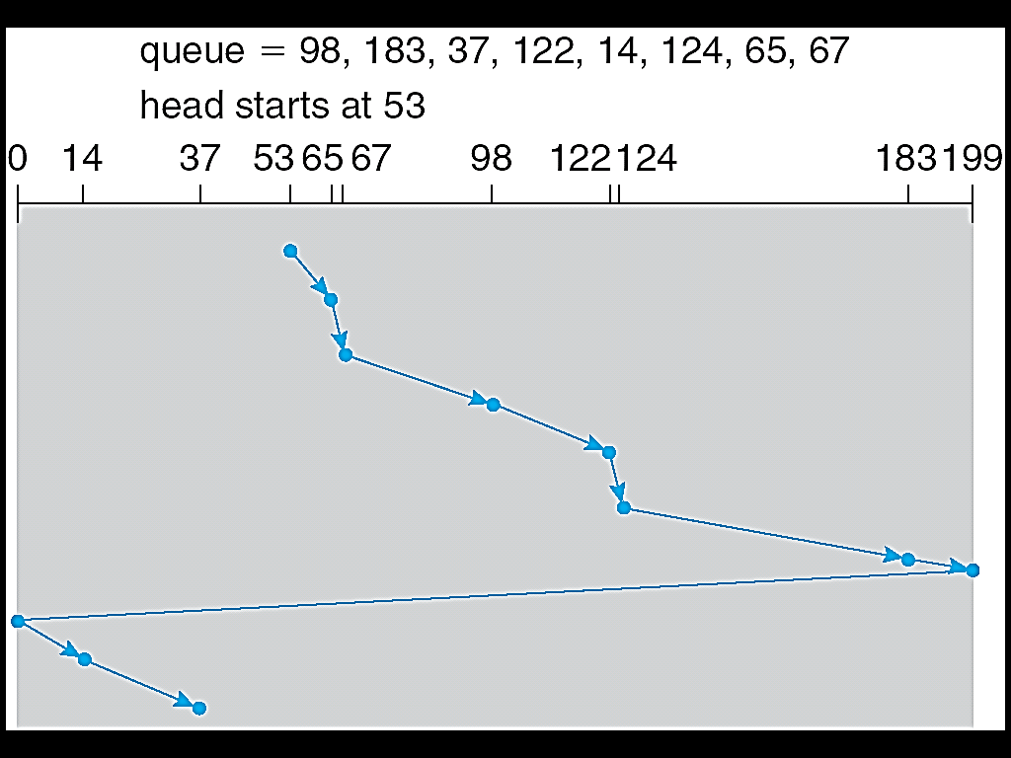
C-SCAN (Circular SCAN)
Provides a more uniform wait time than SCAN
The head moves from one end of the disk to the other, servicing requests as it goes
When it reaches the other end, however, it immediately returns to the beginning of the disk, without servicing any requests on the return trip
Treats the cylinders as a circular list that wraps around from the last cylinder to the first one

Slide 11
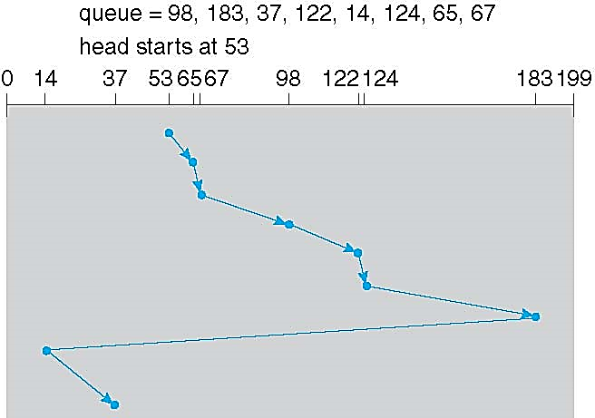
LOOK and C-LOOK (Circular LOOK)
LOOK a version of SCAN
C-LOOK a version of C-SCAN
Arm only goes as far as the last request in each direction, then reverses direction immediately, without first going all the way to the end of the disk

Slide 12
Which one is better?
SSTF is common and has a natural appeal: good performance
SCAN and C-SCAN perform better for systems that place a heavy load on the disk: less starvation
Performance depends on the number and types of requests

Slide 13
Disk Attachment

Slide 14
Disk attachment
1) Host-attached storage
2) Network-attached storage (NAS)
3) Storage-area network (SAN)

Slide 15
1) Host-attached storage
Accessed through PC I/O ports talking to I/O busses
The typical desktop PC uses an I/O bus architecture, called IDE or ATA
Maximum of 2 drivers per I/O bus
A newer, similar protocol that has simplified cabling is SATA
SCSI is a bus, up to 16 devices on one cable
Fiber Channel (FC) is high-speed serial architecture

Slide 16
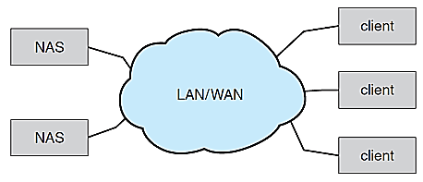
2) Network-attached storage (NAS)
Storage over a network rather than a local connection
Remotely attaching to file systems
NFS and CIFS are common
protocols
Implemented via remote
procedure calls (RPCs)
between host and storage
over typically TCP or UDP on IP network

Slide 17
3) Storage-area network (SAN)
A method for large storage environments
Multiple hosts attached to multiple storage arrays
Storage arrays and Hosts are connected to one or more Fiber Channel Switches

Slide 18
Disk Management

Slide 19
Disk management
Disk formatting
Boot block
Bad blocks

Slide 20
Disk formatting
Low-level formatting, or physical formatting
Dividing a disk into sectors
Each sector can hold header information, plus data, plus error correction code (ECC)
Usually 512 bytes of data but can be selectable
OS data structures to save files
Partition the disk into one or more groups of cylinders, each treated as a logical disk
Logical formatting or “making a file system”
To increase efficiency most file systems group blocks into clusters
Disk I/O done in blocks
File I/O done in clusters

Slide 21
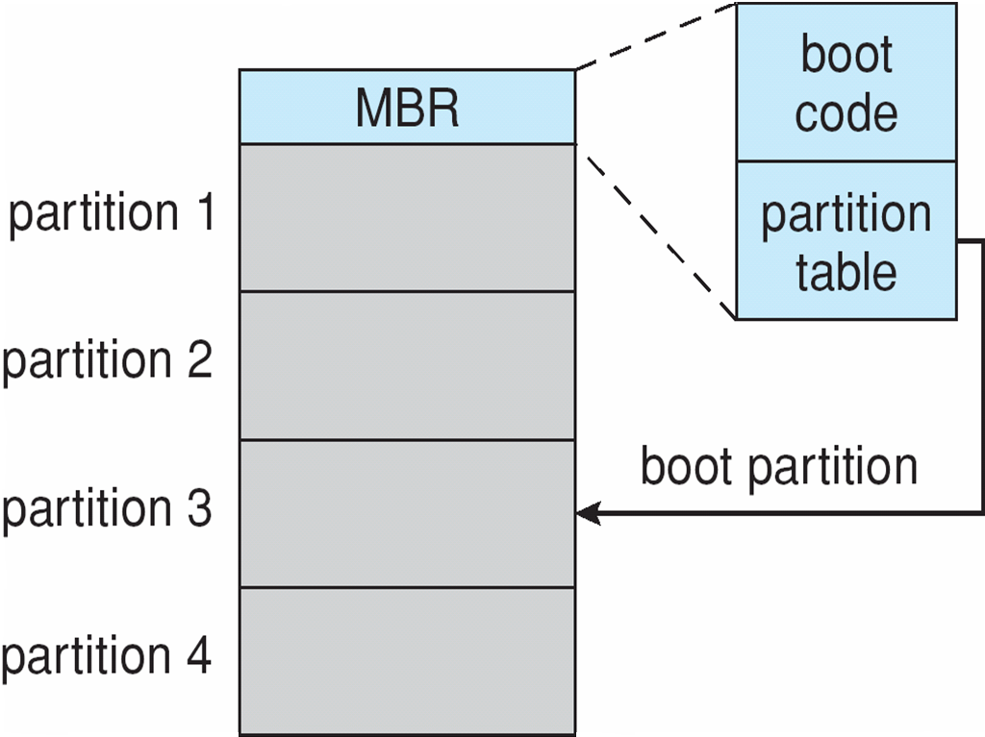
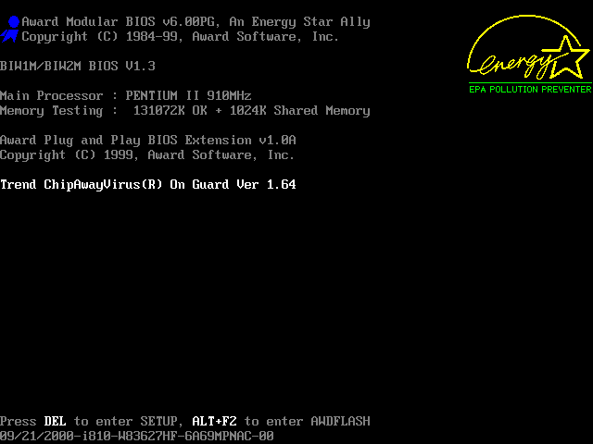
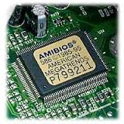
Boot block
Boot block initializes system
The bootstrap is stored in ROM
Bootstrap loader program stored in boot blocks of boot partition

Slide 22
Bad blocks
The controller maintains a list of bad blocks on the disk
The list is initialized during the low-level formatting at the factory and is updated over the file of the disk
Sector sparing or forwarding: replacing each bad sector logically with one of the spare sectors.

Slide 23
Swap space management

Slide 24
Swap-space management
Swap-space — Virtual memory uses disk space as an extension of main memory
Less common now due to memory capacity increases
Swap-space
Normal file system, OR separate disk partition (raw)

Slide 25
RAID Structures

Slide 26
RAID
RAID – Redundant Array of Inexpensive Disks
Multiple disk drives provides reliability via redundancy
Increases the mean time to failure

Slide 28
RAID (0 + 1) and (1 + 0)

Slide 29
Stable-Storage Implementation

Slide 30
Stable-storage implementation
Stable storage: data is never lost (due to failures, etc)
Write-ahead log (WAL) scheme requires stable storage
In a system using WAL, all modifications are written to a log before they are applied.

Slide 31
What are failure’s effects?
Successful completion
The data were written correctly on disk
Partial failure
A failure occurred in the midst of transfer, so only some of the sectors were written with the new data, and the sector being written during the failure may have been corrupted
Total failure
The failure occurred before the disk write started, so the previous data values on the disk remain intact

Slide 32
How to implement stable storage?
If failure occurs during block write, recovery procedure restores block to consistent state
System maintains 2 physical blocks per logical block
Write to 1st physical
When successful, write to 2nd physical
Declare complete only after second write completes successfully
Systems frequently use NVRAM (Non-Volatile RAM) as one physical to accelerate

Slide 33

Questions?

